Slide 1
INVESTMENT CASE STUDY SUBMISSION
Group Name:
Tejas Wagh

Slide 2
Abstract
Data Analysis is a very important aspect when it comes to making right decision in global market.
Here I have tried to explain global trends in investments so that our company can proceed with its decision to choose in companies effectively.
While doing this analysis, I have considered the two main constraints provided by CEO and came up with few choices for investment which I will be presenting today.

Slide 3
Approach towards the goal
Understanding Global trends in investment
Company Data
Funding round data
Sector Classification Data
Merge
master_frame
Clean the master_frame
Merge
Analyse top 9 countries with respect to investment type venture
Conclude with English speaking countries and sectors they have invested in

Slide 4
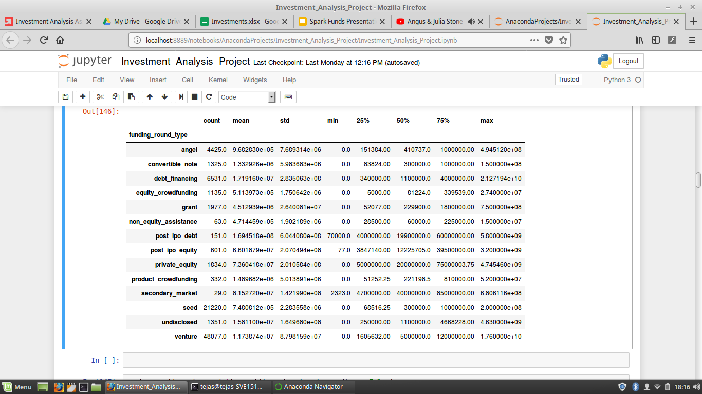
Analysis
We will be looking at 66368 companies worldwide having different investments.

Slide 5
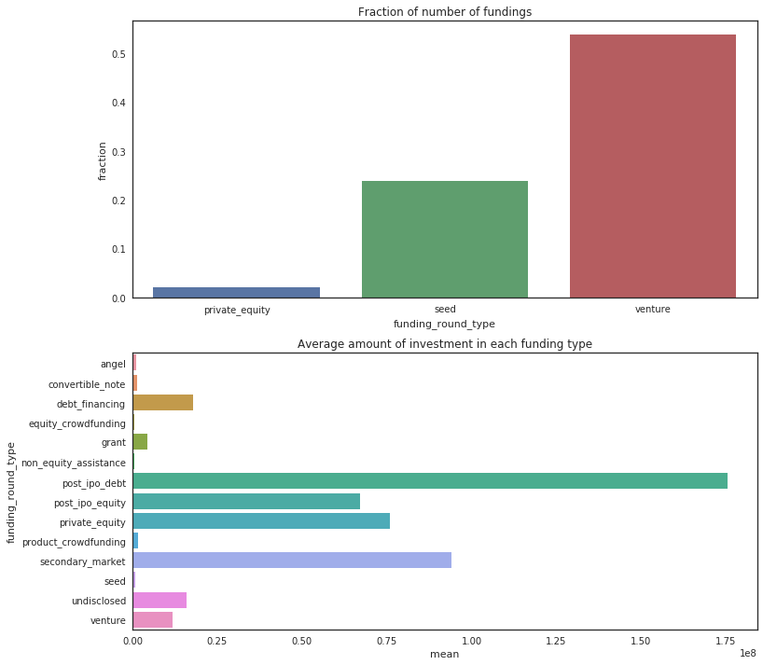
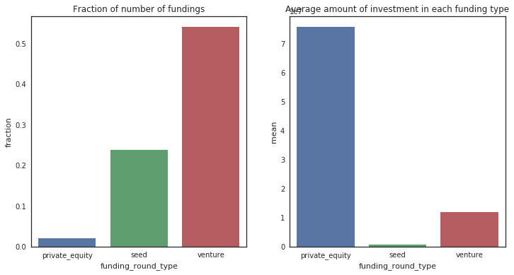
Funding Type Analysis

Slide 6
Funding Type Analysis
From the graphs in previous slides we can observe:
Venture is preferred by very large proportion of companies and average amount raised by these companies falls within the range of 5 to 15 million USD.
Comparatively less number of companies fall in private equity funding but average amount raised by these companies is much more higher than both venture and seed.
Average amount raised by companies in seed is well below required minimum constrain of 5 million USD.
Here, I have decided to go with companies from funding type venture as it will give us a very large number of set of companies to choose from.

Slide 7
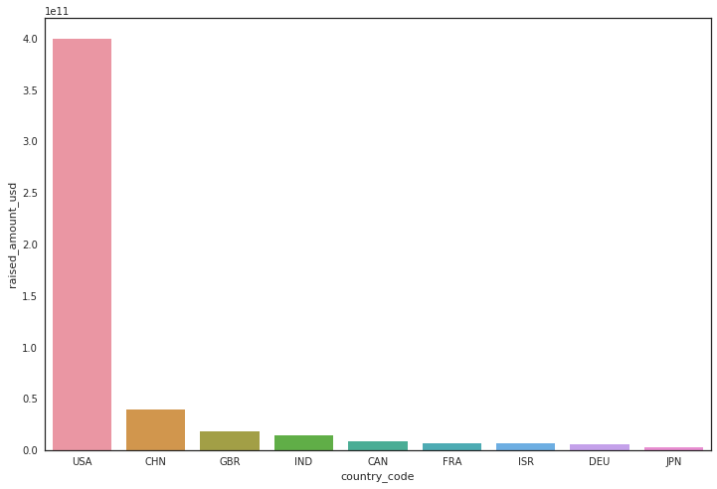
Country Analysis.
Once the type of funding is fixed, now we can look at top 9 countries who have invested in venture:

Slide 8
Country Analysis.
From the graphs in previous slides we can observe:
USA has highest investment in venture, almost 7 times more than China which falls at second place.
Among these top9 countries the top 3 English speaking countries happen to be United States of America(USA), United Kingdom(GBR) and India(IND).

Slide 9
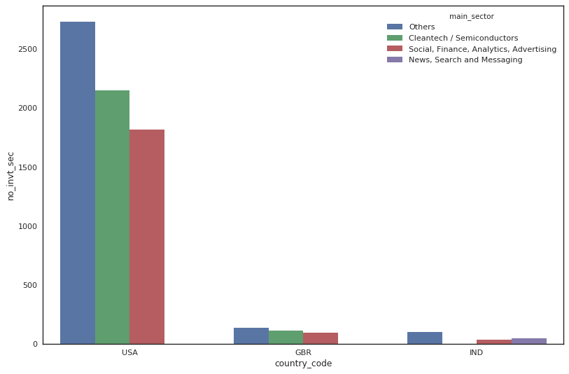
Sector Analysis.

Slide 10
Sector Analysis
Now that we know the top3 English speaking countries, we turn our attention to the the different sectors in which companies from these countries with venture funding type are invested in.
From graph on previous page, we can see in all the three countries the sector other has significantly large number of companies.
In USA and GBR, the second sector happens to be Cleantech/Semiconductors. Whereas in India second sector is News, Search and Messaging.

Slide 11
Conclusion
In all top3 countries, the sector-Other has comparatively large number of companies invested in it, which have raised amount within the range of 5-15 million USD.
In GBR and IND even though number of companies in top sector less, they have still managed to raise amount 5-15 million USD.
From this analysis, I will advise to choose one of the following companies to invest:
USA | GBR | IND
1stdibs/ Bag Borrow or Steal | Notonthehighstreet/ Azure Solutions | CaratLane/ FirstCry.com

